Slide 1
Digital Pathology Software
Group 43
Tristan de Blegiers, Jacob O'Quinn, Ryan Kendrick, Mike Evans, Stephen Maldono

Slide 2
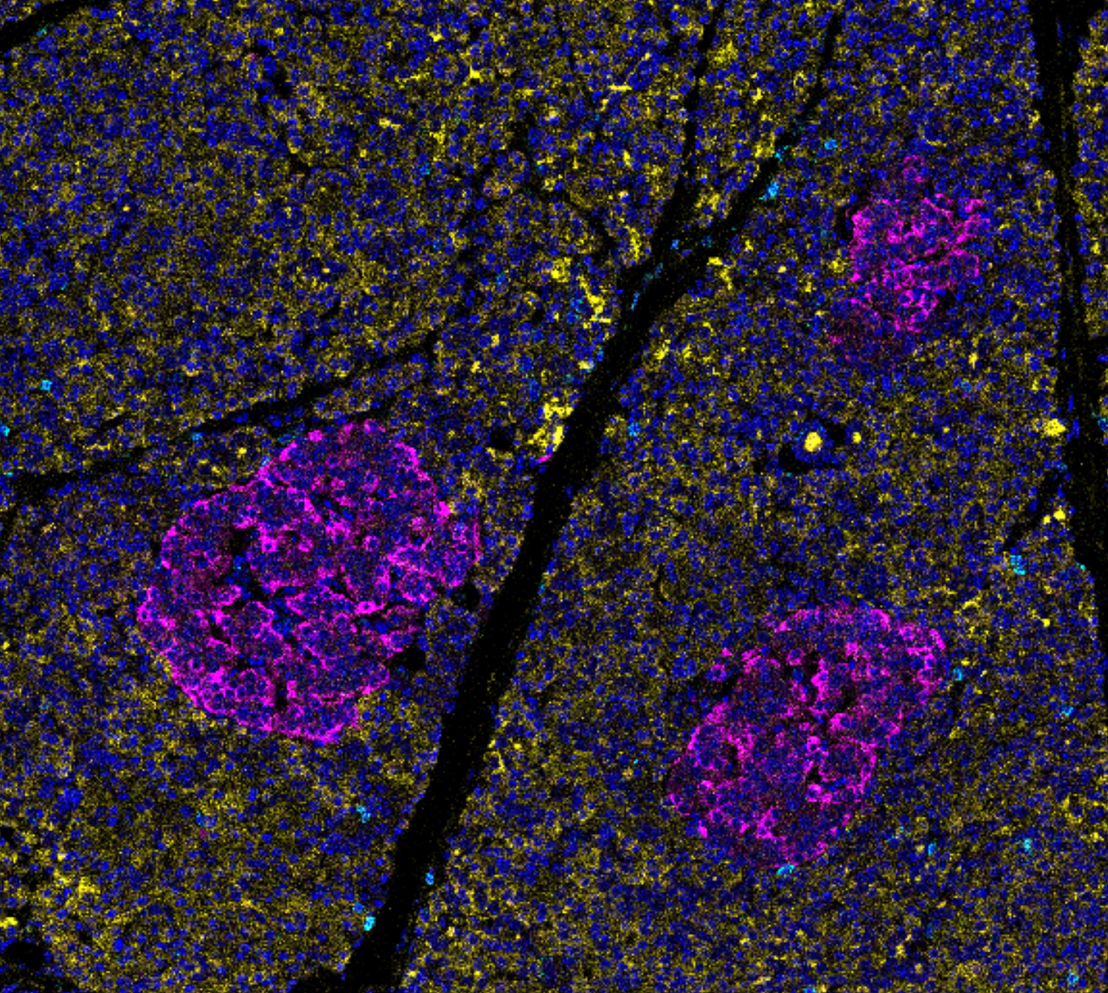
Goal
Create of a computer software
Analyze cells inside a molecular tissues

Slide 3
Why a digital pathology software
Using a microscope to analyze tissues is slow.
Digital pathology is fast and returns a new scale of information
Analyzing tissues’ images requires lots of complex steps.
Limited software availability to help.
That’s where we come in!

Slide 4
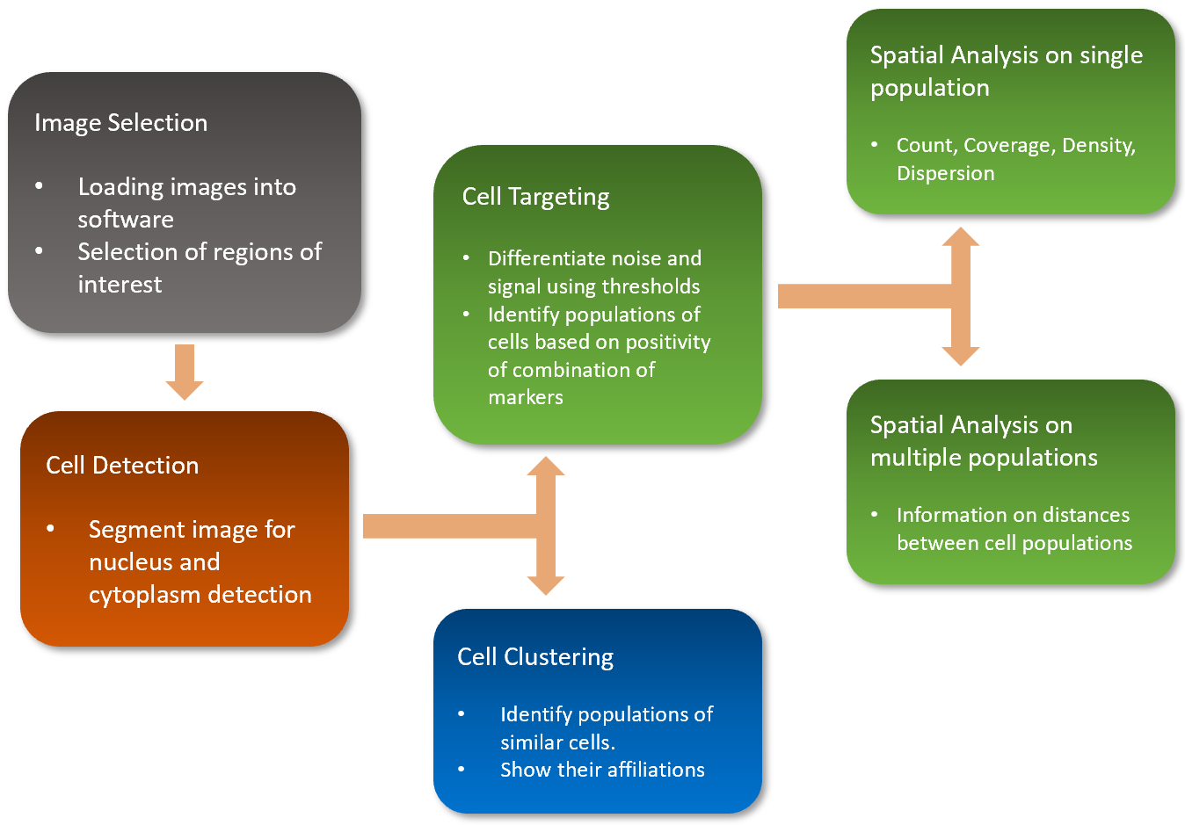
How does it work
After loading the image in the software, we perform:
Cell detection
Cell targeting
Spatial Analysis
Cell clustering

Slide 5
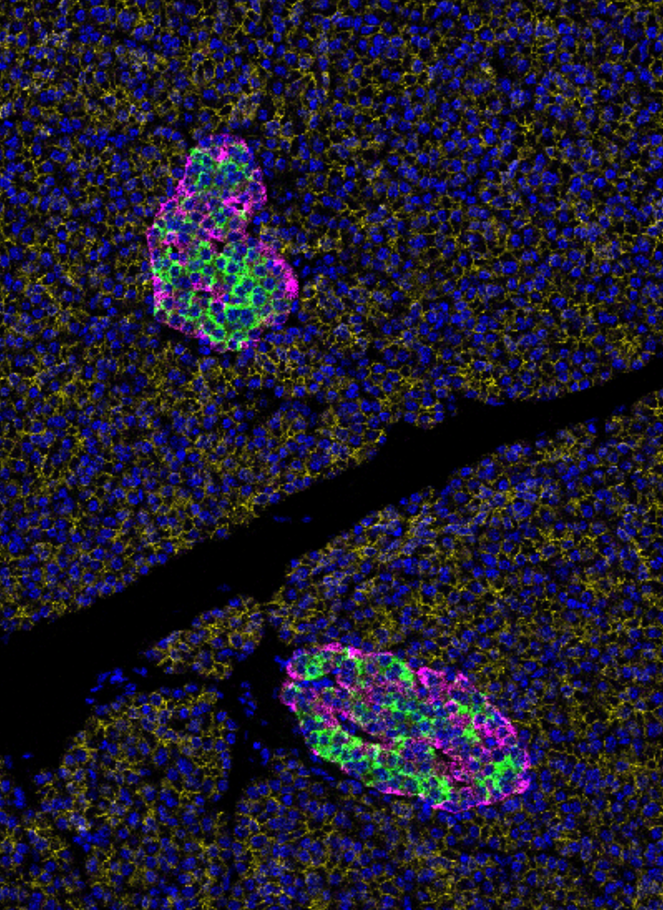
Understanding the image
These images are multi-channels, each channel representing a marker.
While the nucleus marker will help us locate the cell, the other markers will inform us on the cell’s phenotype.
Nucleus
CDH
IAPP
PCSK2

Slide 6
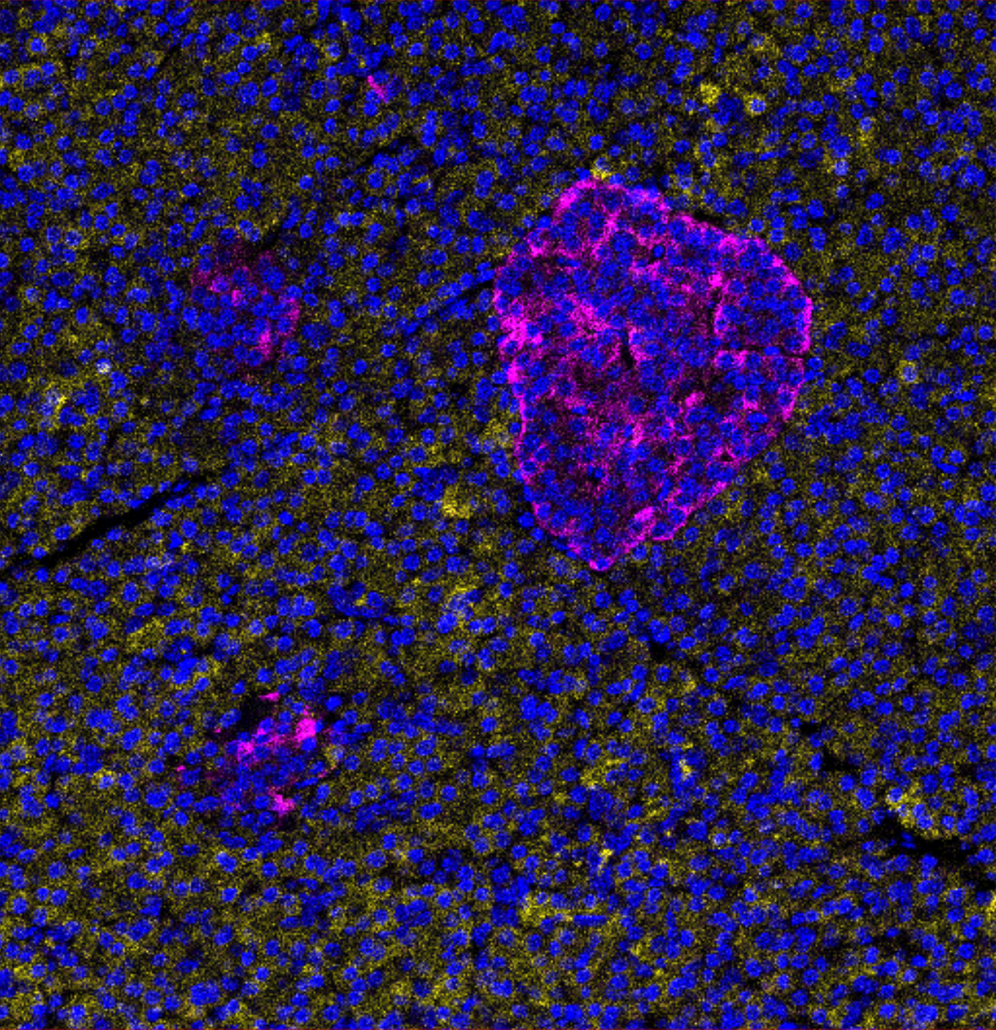
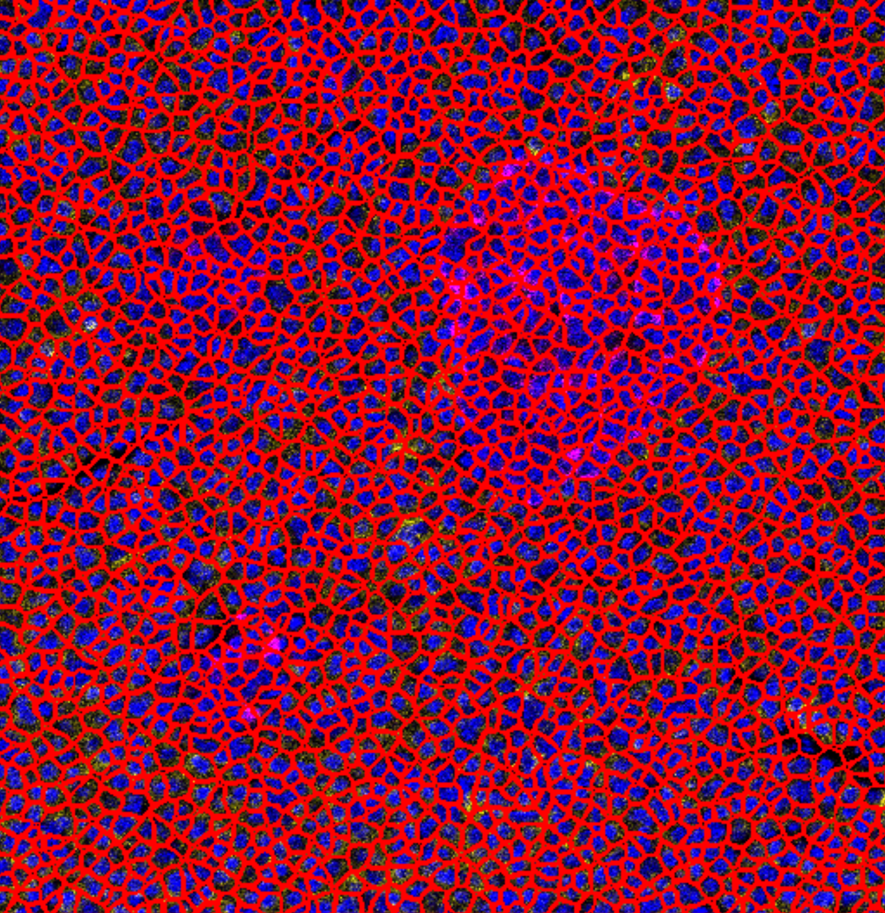
Cell Detection
Using an image segmentation algorithm, we detect each cell inside the tissue.
Each cell is then further looked into.

Slide 7
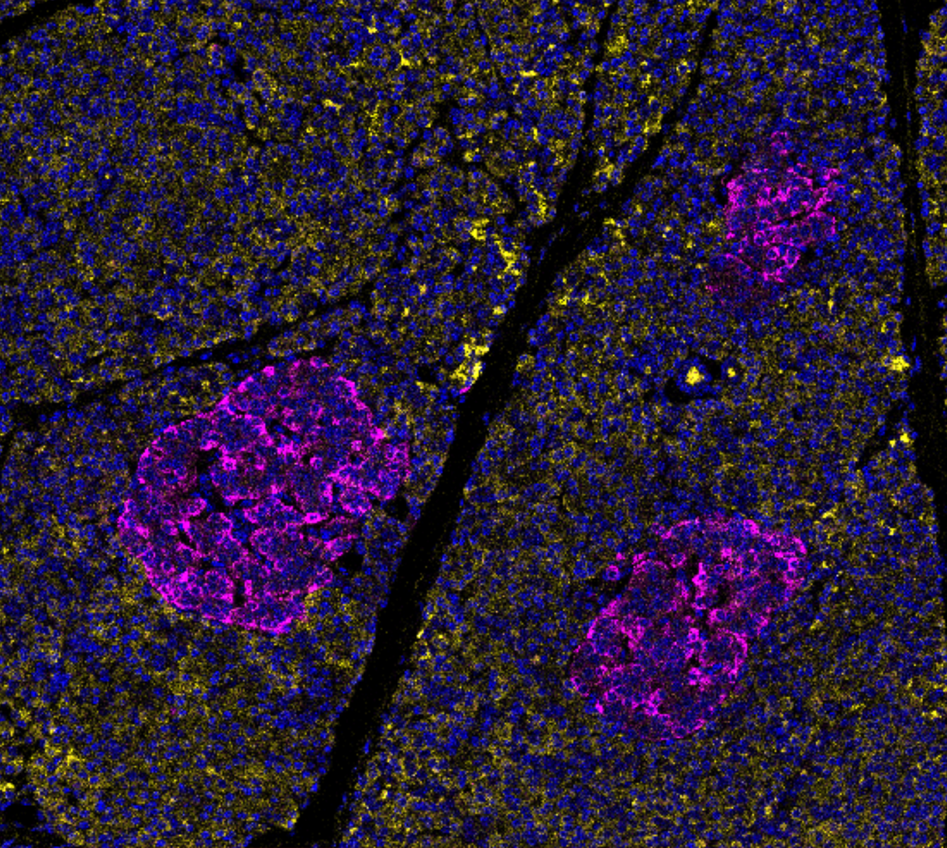
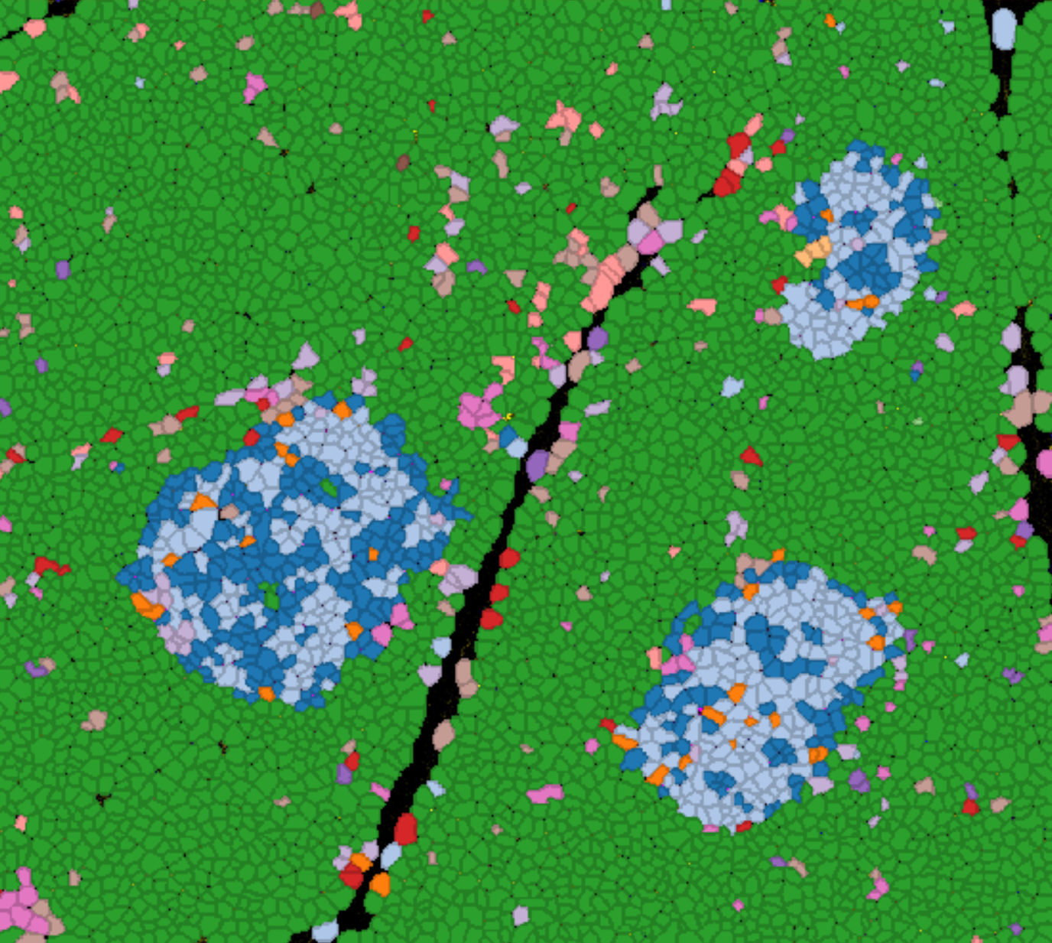
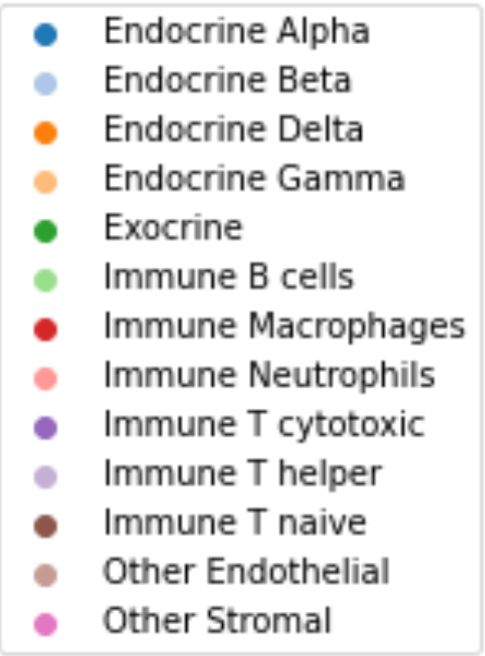
Cell Targeting
Proceeds by looking at the intensity of each marker present in the cell’s area
Uses this information to find each cell’s phenotype

Slide 8
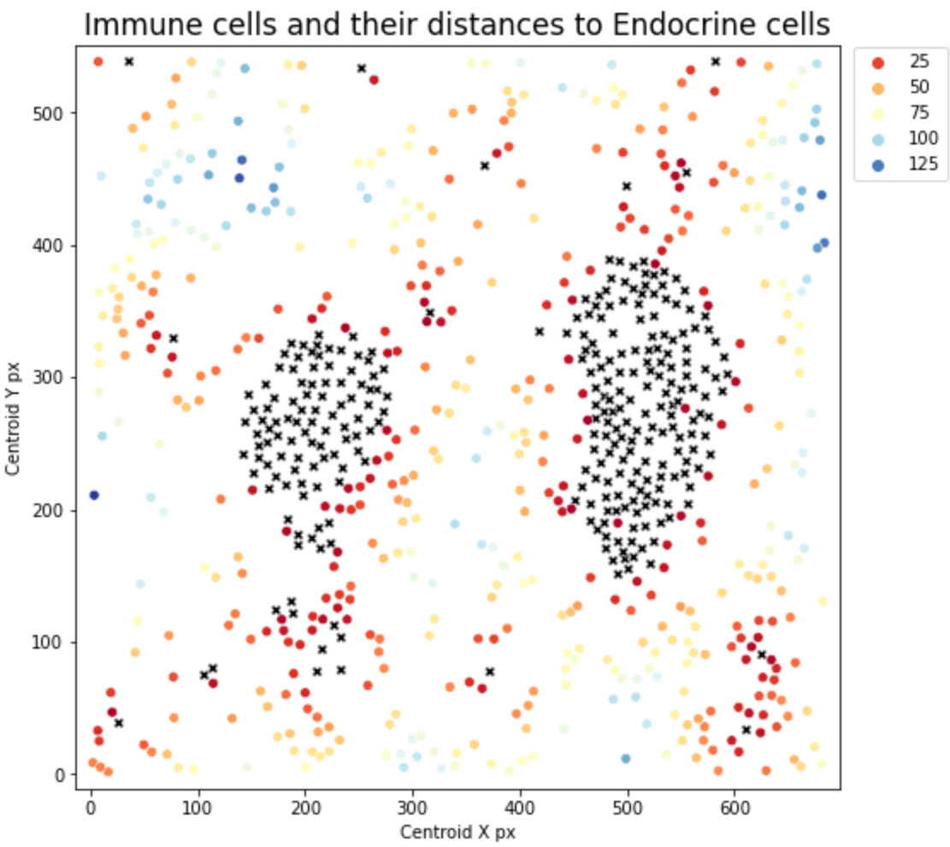
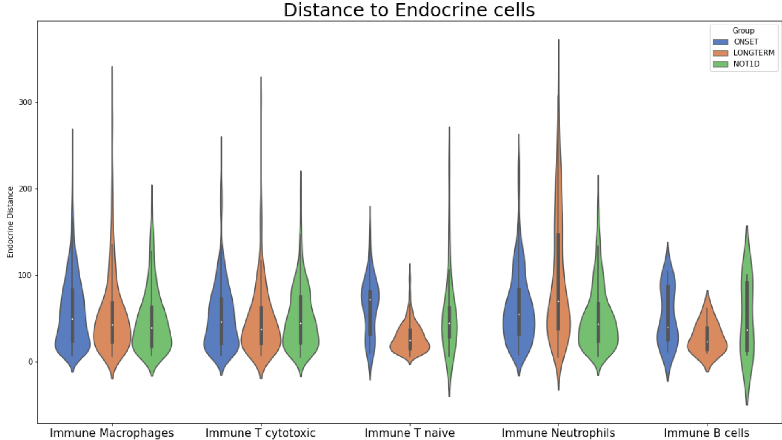
Spatial Analysis
Studies how phenotypes are distributed around the tissue
how different phenotypes interact with each other’s.

Slide 9
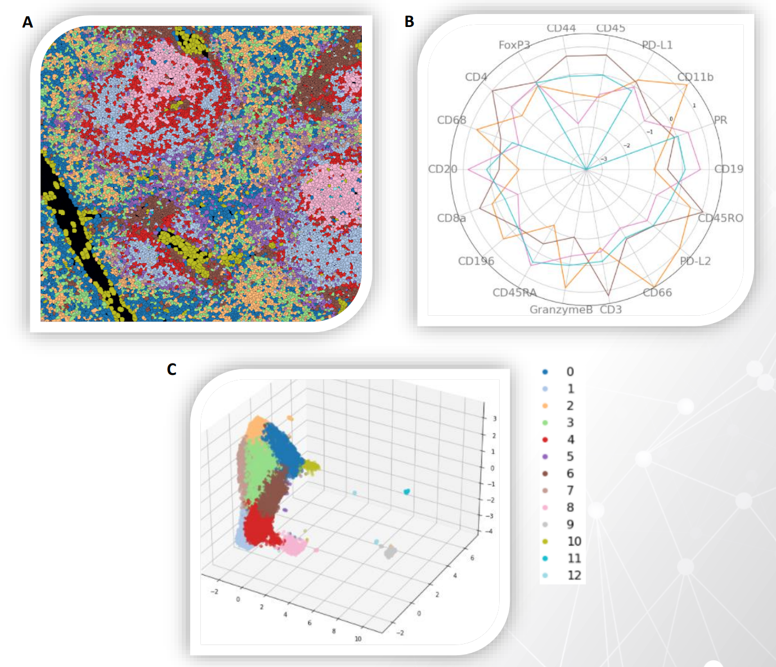
Cell clustering
Alternative to Cell Targeting
Uses an unsupervised machine learning algorithm to clusters cells.

Slide 10

Project impacts
All this information we return through different graphics is key to understanding what’s in the molecular tissue.
This information is key for drug development research companies

Slide 11
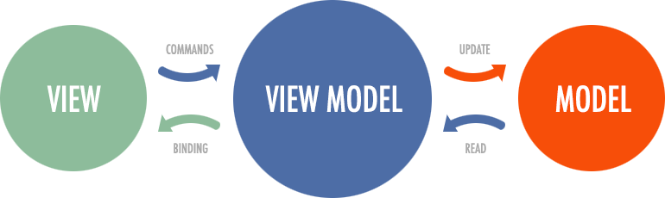
How the software works
We are using a .NET C# environment.
The front end and back end interact using a MVVM pattern
(Model, View, ViewModel)

Slide 12
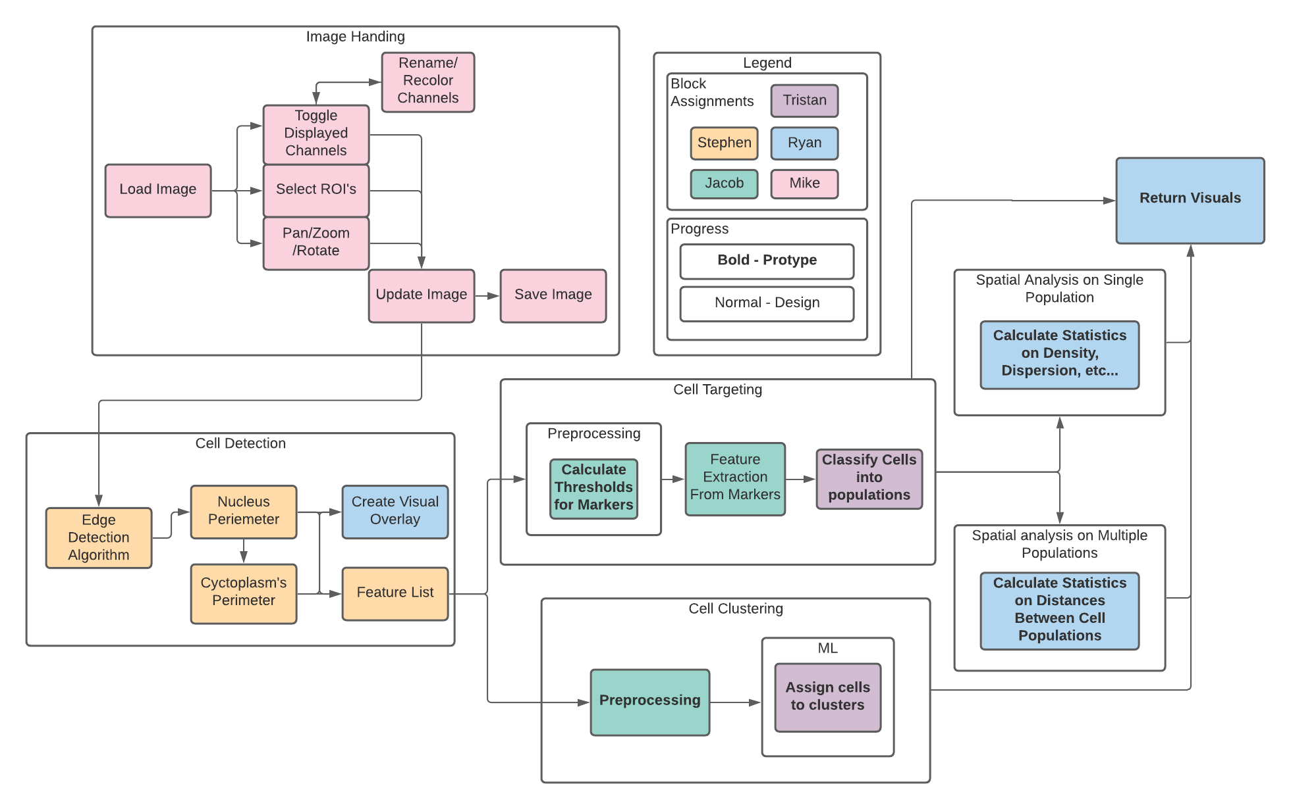
How the software works

Slide 13
Roles
For now,
Project Manager – Tristan
Back End – Ryan and Stephen
Front End – Mike and Jacob
As the project advances, roles will adapt to what needs to be done.

Slide 14
Table of Contents for your Final Design Documentation

Slide 15
Project Milestones

